Slide 1
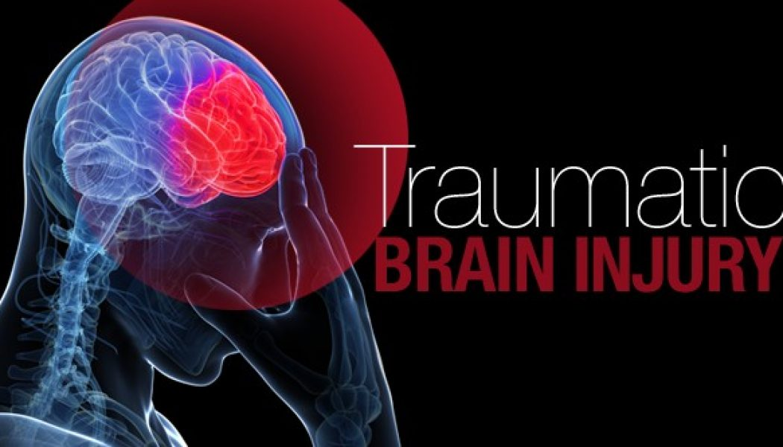
ROSGAYAH ABD MAJID
Hospital Wanita Kanak-Kanak Sabah
26th September 2018

Slide 2
Acknowledgement
A courtesy to Dr Imtinaan for her slides

Slide 3
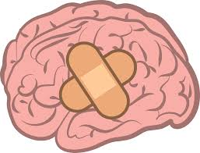
OUTLINES
DEFINITION OF TBI
EPIDEMIOLOGY
ANATOMY
PHYSIOLOGY
PATHOPHYSIOLOGY
CLASSIFICATION OF HEAD INJURY
PAEDIATRIC TRAUMA
SHAKEN BABY SYNDROME
APPROACH AND MANAGEMENT TO TBI
COMPLICATIONS
CONTROVERSIAL ISSUES
SUMMARY
REFERENCES

Slide 4
DEFINITION OF TBI
Non-degenerative, non-congenital insult to the brain from an external mechanical force, possibly leading to temporary or permanent impairment of cognitive, physical and psychosocial functions, with an associated diminished or altered state of consciousness

Slide 5
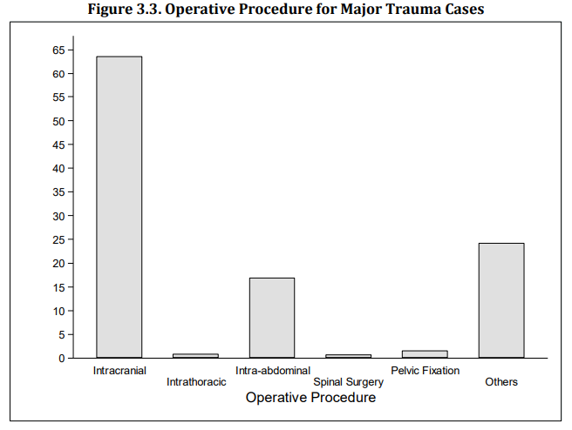
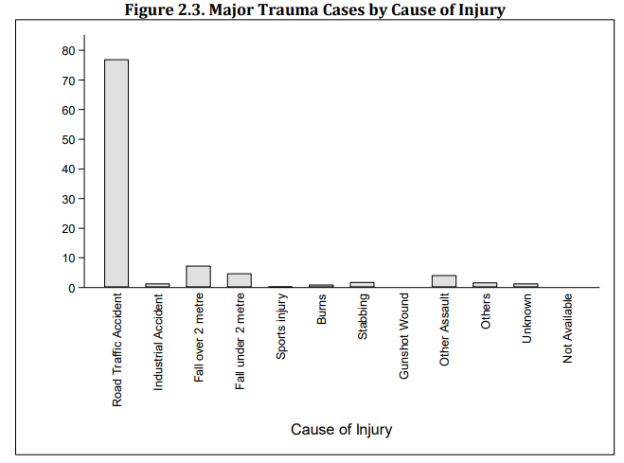
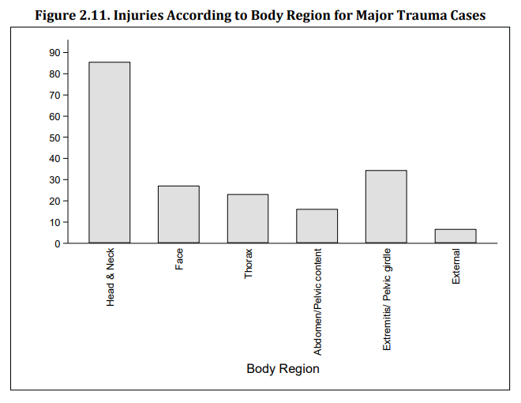
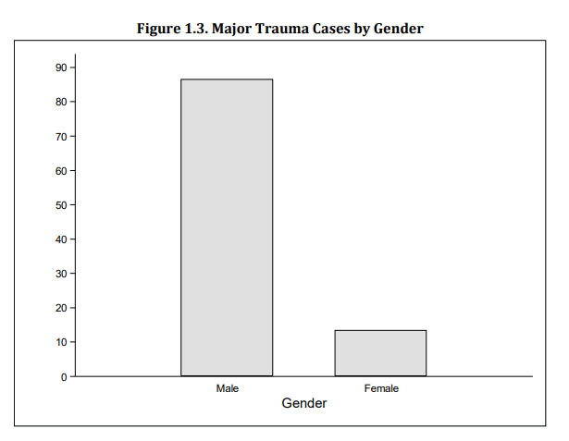
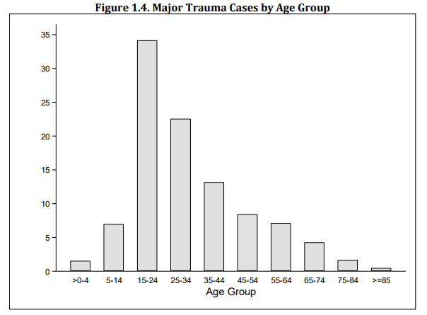
EPIDEMIOLOGY (National Trauma Database 4th Edition, 2009)
Notes:
Approximately 75% of patients with brain injuries who receive medical attention can be categorized as having mild injuries, 15% as moderate, and 10% as severe.

Slide 6
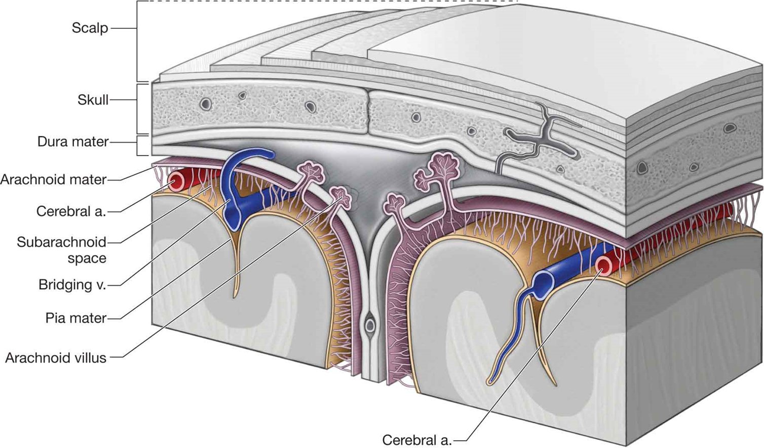
ANATOMY
Notes:
The dura mater is a tough, fibrous membrane that adheres firmly to the internal surface of the skull. At specific sites, the dura splits
into two “leaves” that enclose the large venous sinuses, which provide the major venous drainage from the brain. The midline superior sagittal sinus
drains into the bilateral transverse and sigmoid sinuses, which are usually larger on the right side. Laceration of these venous sinuses can result in
massive hemorrhage.
Meningeal arteries lie between the dura and the internal surface of the skull in the epidural space.
The most commonly injured meningeal vessel is the middle meningeal artery, which is located over the temporal fossa. An expanding hematoma from arterial injury in this location can lead to rapid deterioration and death.
Epidural hematomas can also result from injury to the dural sinuses and from skull fractures, which tend to expand slowly and put less pressure on the underlying brain.
Beneath the dura is a second meningeal layer: the thin, transparent arachnoid mater. Because the dura is not attached to the underlying arachnoid
membrane, a potential space between these layers exists (the subdural space), into which haemorrhage can occur.
Bridging veins that travel from the surface of the brain to the venous sinuses within the dura may tear, leading to the formation of a subdural hematoma.
The third layer, the pia mater, is firmly attached to the surface of the brain. Cerebrospinal fluid (CSF) fills the space between the watertight arachnoid mater and the pia mater (the subarachnoid space), cushioning the brain and spinal cord.
Hemorrhage into this fluid-filled space (subarachnoid hemorrhage) frequently accompanies brain contusion and injuries to major blood vessels at the base of the brain.

Slide 7
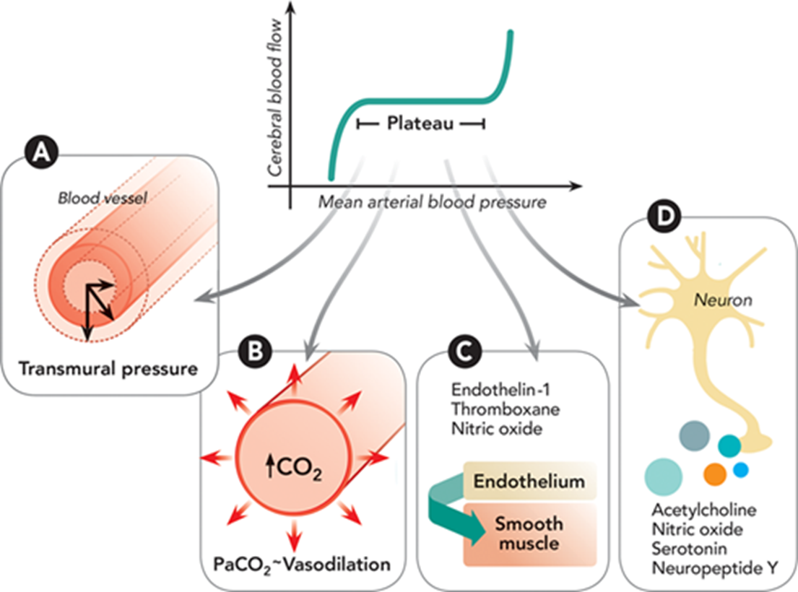
PHYSIOLOGY
Notes:
Illustration of the mechanisms of cerebral autoregulation. (A) In the myogenic mechanism, changes in the transmural pressure influence changes in arterial diameter through contraction or relaxation of the smooth muscle. (B) In the metabolic mechanism, the concentration of carbon dioxide (CO₂) produced in the oxidative phosphorylation process affects small artery diameter. (C) The endothelial mechanism is based on the paracrine secretion of substances (nitric oxide and vasoconstrictors like endothelin-1 and thromboxane A2) that stimulate the smooth muscle. (D) In the neurogenic mechanism, neuroglial cells contribute to the control of moderate- and small-diameter vessels by secreting different neurotransmitters with vasoactive properties.
Autoregulation is a process of adjustment on the part of the brain’s arterioles that keeps cerebrovascular resistance constant over a range of CPP. Increased CPP causes stretching of the walls of the arterioles, which compensate by dilating and relieving this pressure. Likewise, in the setting of decreased pressure, the arterioles constrict to maintain CPP. This autoregulation prevents transient pressure increases from being transmitted to smaller distal vessels. When the MAP is less than 65 mm Hg or greater than 150 mm Hg, the arterioles are unable to autoregulate, and blood flow becomes entirely dependent on the blood pressure, a situation defined as "pressure-passive flow." The CBF is no longer constant but is dependent on and proportional to the CPP.

Slide 8
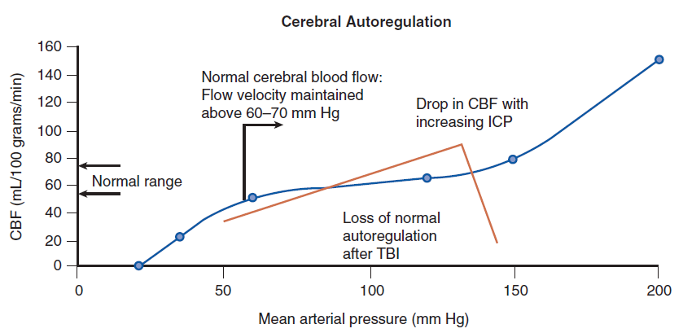
PHYSIOLOGY
CPP = MAP – ICP
Notes:
CPP is the pressure gradient acting across the cerebrovascular bed and, therefore, a major factor in determining cerebral blood flow (CBF). ^{[31]} CBF is kept constant in spite of wide variation in CPP and MAP by autoregulation.
Elevated ICP can lead to death or devastating neurological damage either by reducing cerebral perfusion pressure (CPP) causing cerebral ischemia or
by compressing and causing herniation of the brainstem or other vital structures.
Elevated ICP carries a mortality rate of around 20%

Slide 9
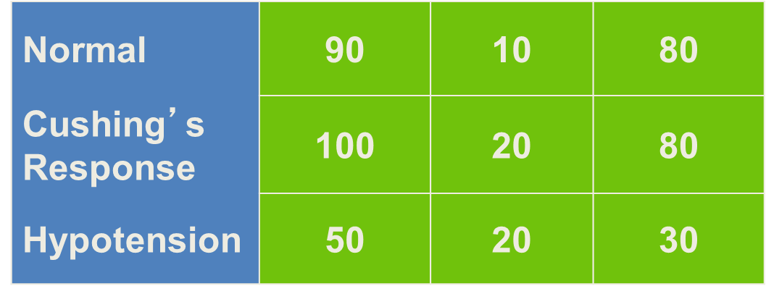
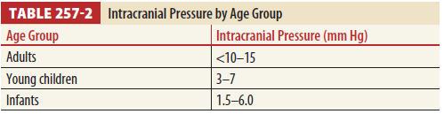
PATHOPHYSIOLOGY
MAP – ICP = CPP
10 mm Hg = Normal
>20 mm Hg = Abnormal
>40 mm Hg = Severe
Notes:
CPP is the pressure gradient acting across the cerebrovascular bed and, therefore, a major factor in determining cerebral blood flow (CBF). ^{[31]} CBF is kept constant in spite of wide variation in CPP and MAP by autoregulation.
Elevated ICP can lead to death or devastating neurological damage either by reducing cerebral perfusion pressure (CPP) causing cerebral ischemia or
by compressing and causing herniation of the brainstem or other vital structures.
Elevated ICP carries a mortality rate of around 20%

Slide 10
MONROE-KELLIE DOCTRINE
Notes:
Intracranial Pressure
Elevation of intracranial pressure (ICP) can reduce cerebral perfusion and cause or exacerbate ischemia. The normal ICP for patients in the
resting state is approximately 10 mm Hg. Pressures greater than 22 mm Hg, particularly if sustained and refractory to treatment, are associated with
poor outcomes.
The doctrine states that the total volume of the intracranial contents must remain constant, because the cranium is a rigid container incapable of expanding. When the normal intracranial volume is exceeded, ICP rises. Venous blood and CSF can be compressed out of the container, providing a degree of pressure buffering
Csf translocate into spinal subarachmoid space
The Monro–Kellie Doctrine Regarding Intracranial Compensation for Expanding Mass. The total volume of the intracranial
contents remains constant. If the addition of a mass such as a hematoma compresses an equal volume of CSF and venous blood, ICP remains
normal. However, when this compensatory mechanism is exhausted, ICP increases exponentially for even a small additional increase in
hematoma volume.

Slide 11
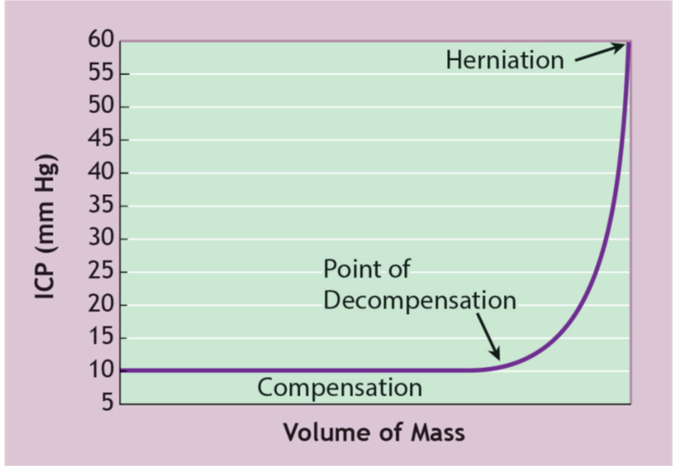
Volume-Pressure curve
Notes:
FIGURE 6-5 Volume–Pressure Curve. The intracranial contents initially can compensate for a new intracranial mass, such as a subdural or epidural hematoma. Once the volume of this mass reaches a critical threshold, a rapid increase in ICP often occurs, which can lead to reduction or cessation of cerebral blood flow.

Slide 12
CLASSIFICATIONS OF HEAD INJURY

Slide 13
GLASGOW COMA SCALE (glasgowcomascale.org)
ORIGINAL SCALE | REVISED SCALE | SCORE
EYE OPENING (E) Spontaneous To speech To pain None | EYE OPENING (E) Spontaneous To speech To pain None Non-testable | 4 3 2 1 NT
VERBAL RESPONSE (V) Oriented Confused Inappropriate words Incomprehensible sounds None | VERBAL RESPONSE (V) Oriented Confused Inappropriate words Incomprehensible sounds None Non-testable | 5 4 3 2 1 NT
BEST MOTOR RESPONSE (M) Obeys commands Localizes pain Flexion withdrawal to pain Abnormal flexion (decorticate) Extension (decerebrate) None (flaccid) | BEST MOTOR RESPONSE (M) Obeys commands Localizes pain Flexion withdrawal to pain Abnormal flexion (decorticate) Extension (decerebrate) None (flaccid) Non-testable | 6 5 4 3 2 1 NT

Slide 14
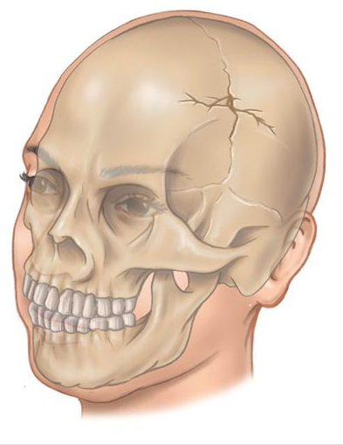
Skull fracture
Location: vault vs basilar
Pattern: linear, depressed, comminuted
Open vs closed
Notes:
A skull fracture is a break in the skull bone and generally occurs as a result of direct impact. The skull is deformed by localized impact, which may damage the cranial contents even when the skull does not fracture. If the force and deformation is excessive, the skull fractures at or near the site of impact. Uncomplicated skull fractures themselves rarely produce neurologic deficit, but the associated intracranial injury may have serious neurologic sequelae. A fracture indicates that substantial force has been applied to the head and is likely to have damaged the cranial contents.

Slide 15
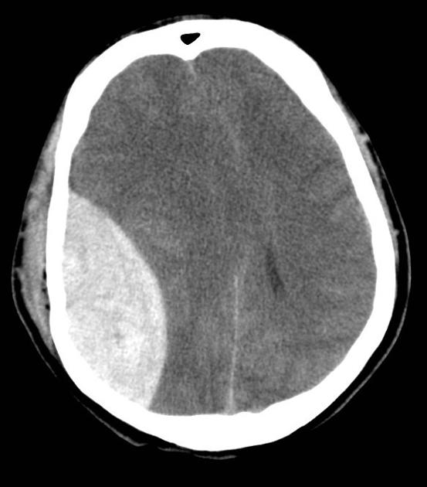
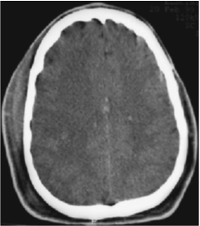
Intracranial lesions
Focal
Epidural
Subdural
Intracerebral
Diffuse
Concussion
Multiple contusions
Hypoxic/ischemic injury
Axonal injury
Notes:
Diffuse brain injuries range from mild concussions, in which the head CT is normal, to severe hypoxic, ischemic injuries. With a concussion, the patient has a transient, nonfocal neurological disturbance that often includes loss of consciousness. Severe diffuse injuries often
result from a hypoxic, ischemic insult to the brain from prolonged shock or apnea occurring immediately after the trauma. I

Slide 16
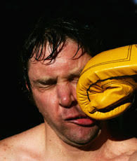
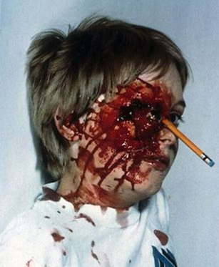
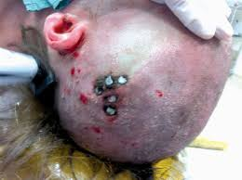
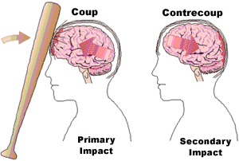
Blunt trauma
Penetrating trauma

Slide 17
Pathophysiology
Primary
initial insult due to mechanical forces that produce high levels of direct damage and strain to the brain parenchyma
Contusions
Hematoma (subdural, epidural, intraparenchymal, intraventricular, subarachnoid)
Diffuse axonal injury (stress or damage to axons)
Secondary
Results by secondary neurotoxic cascade due to secondary insults (hypotension, hypoxemia, hyperglycemia) resulting in
Cerebral edema
Cerebral herniation
Notes:
Secondary neurotoxic cascade result in series of cellular and subcellular events.massive release of neurotransmitter such as glutamate to presynaptic space will cause ionic shift activate cytoplasmic and nuclear enzymes induce mitochondrial damage and lead to cell death and necrosis.

Slide 18
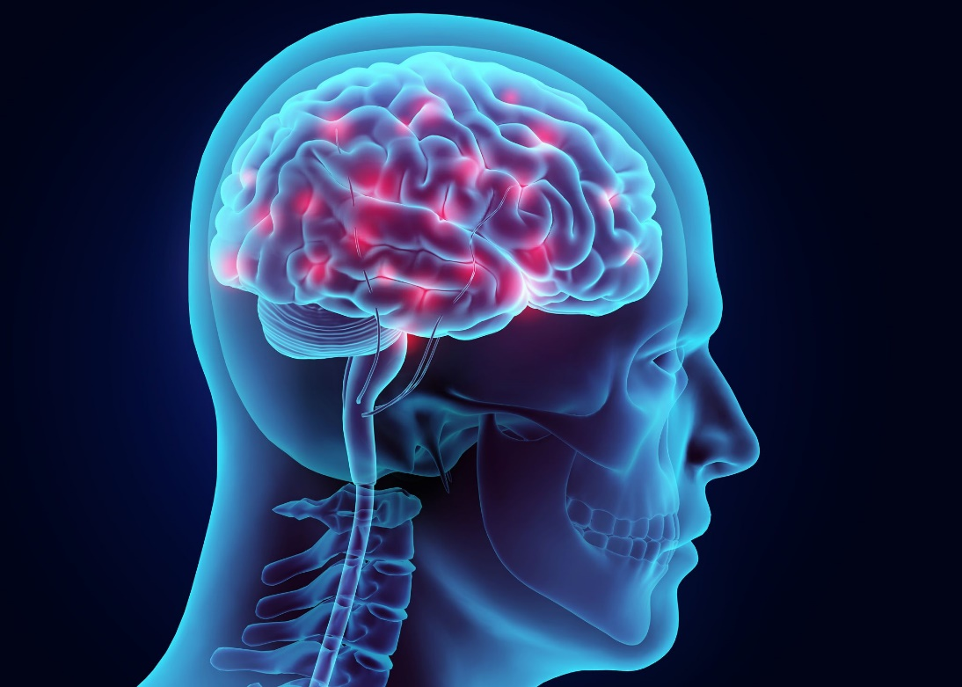
APPROACH TO TBI MANAGEMENT

Slide 19
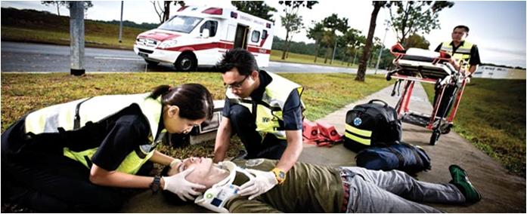
PREHOSPITAL CARE
ABCDE
Minimize secondary brain injury
Administer oxygen
C-spine protection
Maintain normal blood pressure
Initial clinical findings and physical exam as reported by EMS are an essential component of triaging and managing TBI

Slide 20
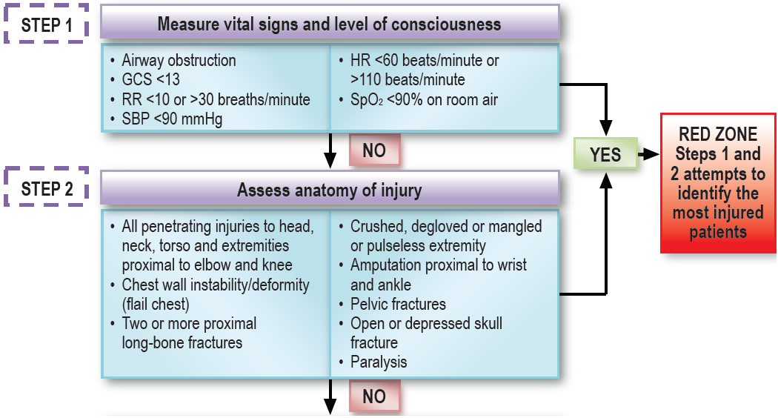
TRIAGE

Slide 21
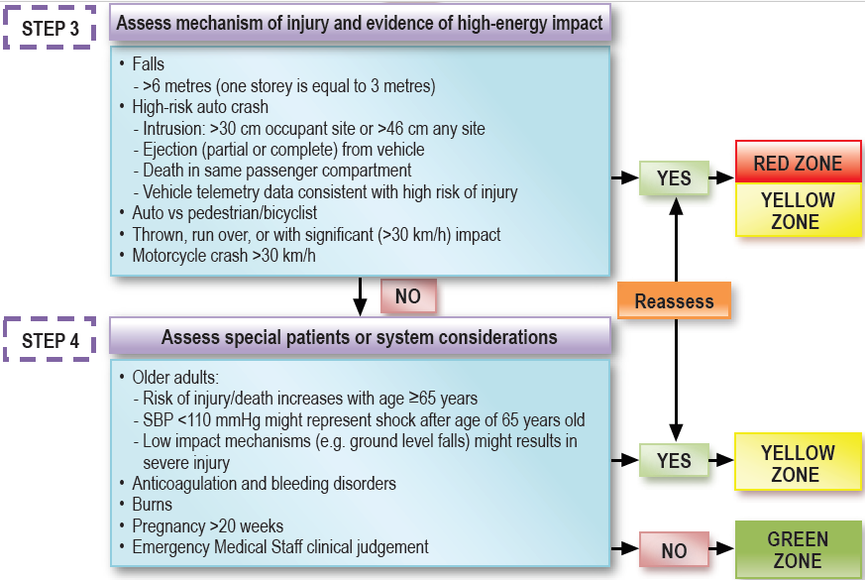

Slide 22

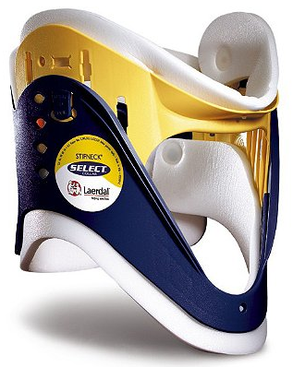
Airway Protection
Endotracheal intubation if severe TBI
Prevent hypoxaemia
Maintain a PCO2 of approximately 35 mm Hg.
Prolonged hyperventilation with PCO2 < 25 mm Hg is not recommended
Maintain cervical in-line immobilization all the time

Slide 23

Treat primary source of hypotension
Prevent hypotension:
Maintain systolic blood pressure (SBP)
≥ 100 mmHg for patients 50 to 69 years OR
≥ 110 mm Hg for patients 15 to 49 years OR > 70 years
(ATLS 10th Edition)
Ringer’s lactate solution or normal saline is recommended
Hyponatremia is associated with brain edema and should be prevented.
Notes:
Hypotension usually is not due to the brain injury
itself, except in the terminal stages when medullary
failure supervenes or there is a concomitant
spinal cord injury. Intracranial hemorrhage cannot
cause hemorrhagic shock. If the patient is hypotensive,
Remember, the neurological examination of patients
with hypotension is unreliable. Hypotensive patients
who are unresponsive to any form of stimulation
can recover and substantially improve soon after
normal blood pressure is restored. It is crucial to
immediately seek and treat the primary source of
the hypotension.

Slide 24

GCS, pupillary response and neurological deficit
If emergency intubation is necessary, obtain
pre-intubation GCS
UNRESPONSIVE PATIENT WITH | MAY SUGGEST
Single fixed and dilated pupils | Intracranial hematoma with uncal herniation
Bilateral fixed and dilated pupils | Increased ICP with poor brain perfusion Bilateral uncal herniation Drug effect (eg: Atropine) Severe hypoxia
Bilateral pinpoints pupils | Central pontine lesion Opiate exposure

Slide 25
Don’t forget to complete your secondary survey
Notes:
AMPLE
Obtain an accurate history:
The patient, witnesses, and EMS crews
Mechanism of injury and overall severity of TBI e.g: height of fall, impact surface condition, damage sustained to vehicle, airbag deployment, seat belt use, history of ejection from the vehicle, or report of fatalities at the scene.
Premorbid medical history, medications, drug use, and/or alcohol intoxication

Slide 26
DIAGNOSTIC IMAGING
Notes:
For patients with moderate or severe traumatic brain injury, clinicians must obtain a head CT scan as soon as possible after hemodynamic normalization. CT scanning also should be repeated whenever there is a change in the patient’s clinical status and routinely within 24 hours of injury for patients with subfrontal/ temporal intraparenchymal contusions, patients receiving anticoagulation therapy, patients older than 65 years, and patients who have an intracranial hemorrhage with a volume of >10 mL. CT findings of significance include scalp swelling and subgaleal hematomas at the region of impact.
Skull fractures can be seen better with bone windows but are often apparent even on the soft-tissue windows. Crucial CT findings are intracranial blood, contusions, shift of midline structures (mass effect), and obliteration of the basal cisterns (see n FIGURE 6-7). A shift of 5 mm or greater often indicates the need for surgery to evacuate the blood clot or contusion causing the shift.

Slide 27
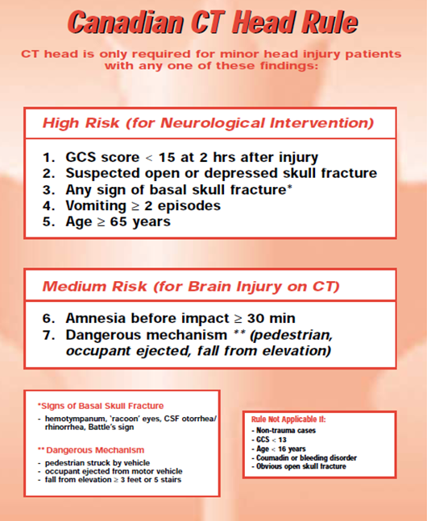
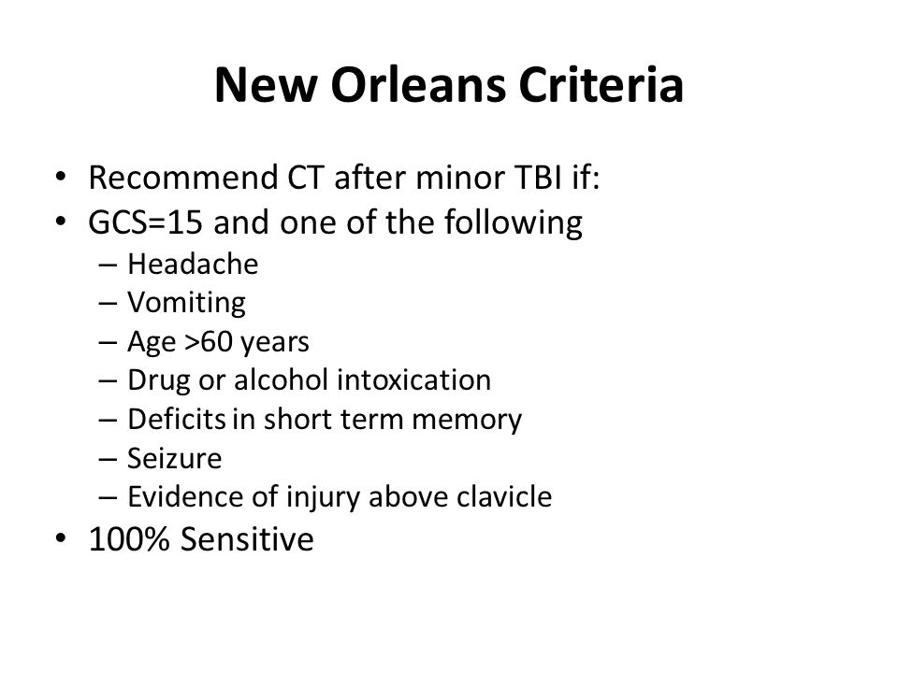
*Sensitivity 100%, Specificity 12.7%
*Source: JAMA. 2005;294(12):1511-1518. doi:10.1001/jama.294.12.1511 on Comparison of the Canadian CT Head Rule and the New Orleans Criteria in Patients With Minor Head Injury
*Sensitivity 100%, Specificity 50.6%

Slide 28
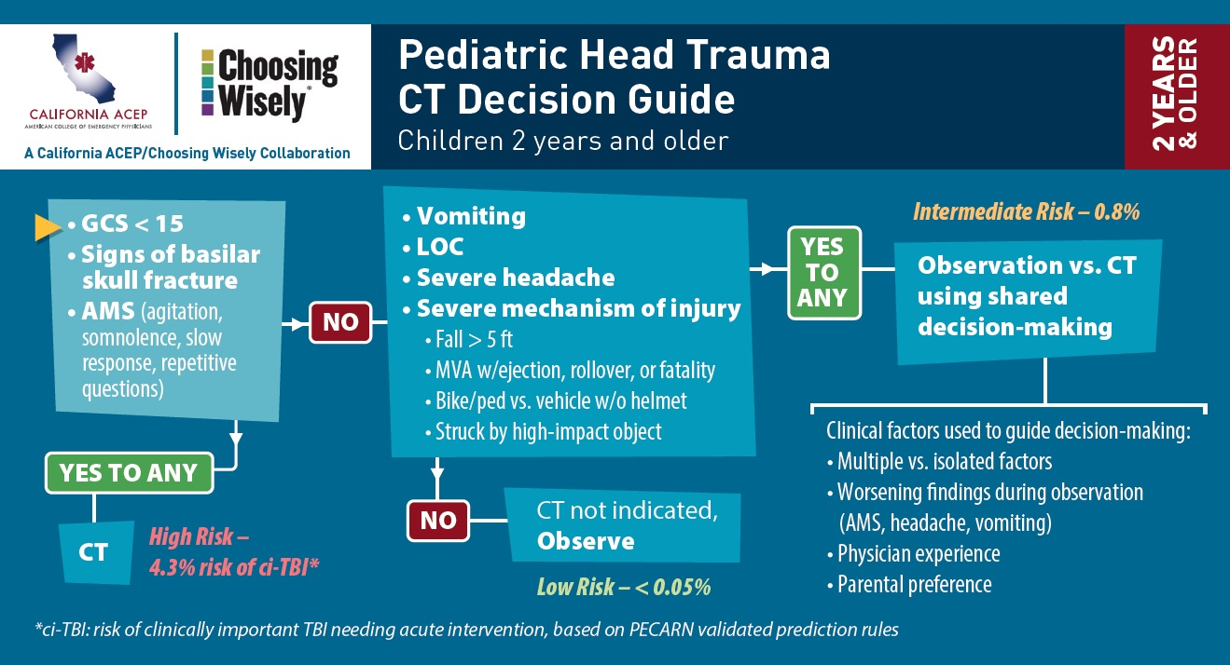
*Sensitivity 100%, Specificity 62%
*Source: Ann Emerg Med. 2014 Aug; 64(2): 145–152.e5 on Comparison of PECARN, CATCH, and CHALICE Rules for Children with Minor Head Injury: A prospective cohort study

Slide 29
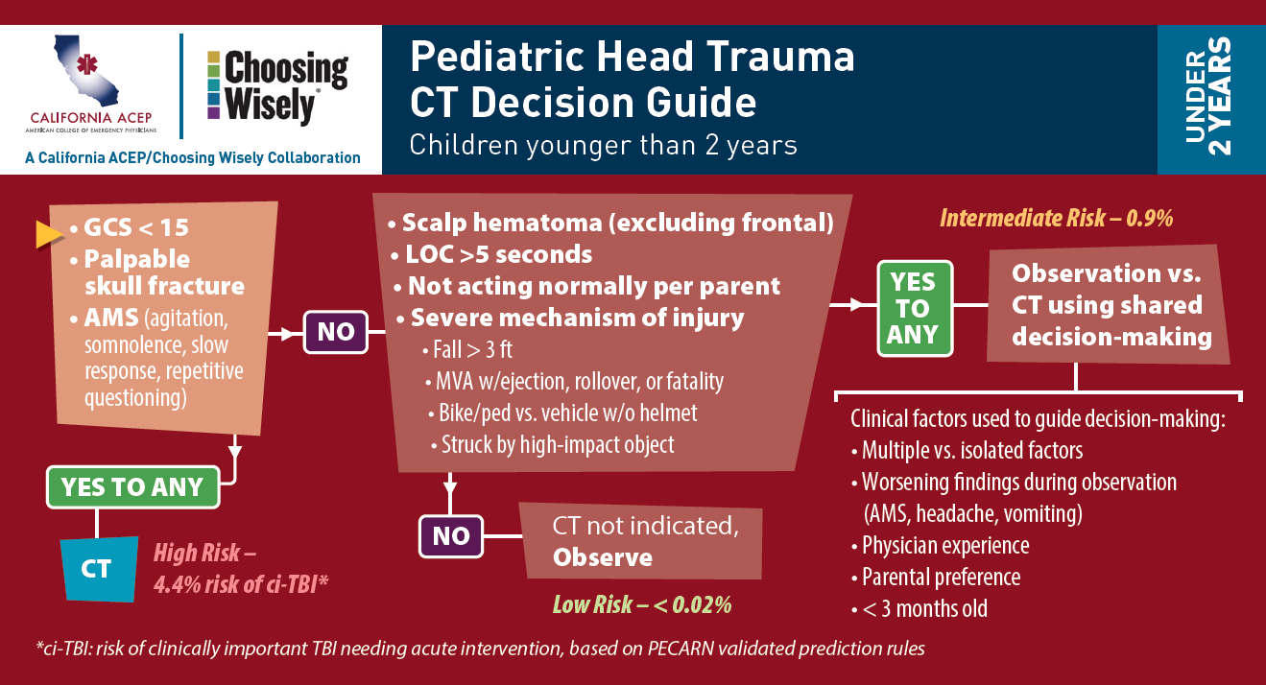
*
*Sensitivity 100%, Specificity 62%
*Source: Ann Emerg Med. 2014 Aug; 64(2): 145–152.e5 on Comparison of PECARN, CATCH, and CHALICE Rules for Children with Minor Head Injury: A prospective cohort study

Slide 30
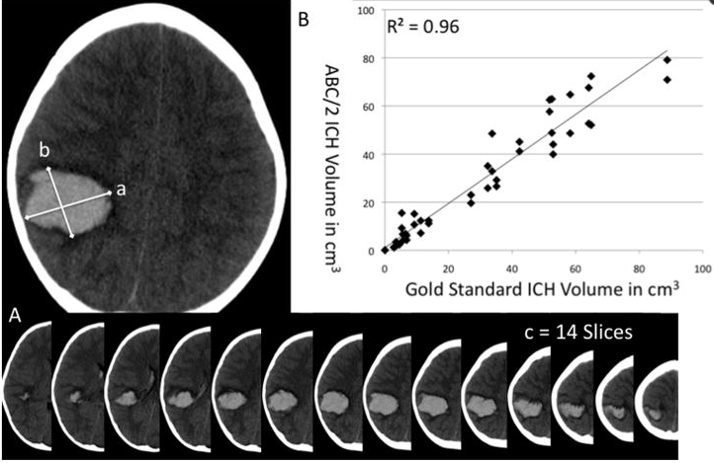
How to calculate bleed size?
ABC/2: A baseline intracerebral haemorrhage volume of >50-60 mL is a poor prognostic marker!
Notes:
1. Review the CT of the head 2. Find the slice with the largest haematoma (Slice X) 3. Measure the longest diameter (in cm) of the haematoma on the 'Slice X'; This diameter would be 'A' 4. On the slice 'X', measure the longest diameter perpendicular to 'A'. This measurement would be 'B' 5. Provided the slice thickness is 1cm (i.e. 10 mm), The 'C' can be ascertained in the following way: 5a. For the Slice 'X' ascribe 1 to C 5b. Add 1 to 'C', for every CT slice with the haematoma with an area > 75 % of that seen in slice X 5c. Add 0.5 to 'C', for every CT slice with the haematoma with an area 75 %-25% of that seen in slice X 5d. Ignore any slices which appear to have haematoma area less than 25 % of that seen in slice X 6. Haematoma volume = (A * B * C) / 2
ABC/2 is a fast and simple method for estimating the volume of intracerebral haemorrhage (or any other ellipsoid lesion for that matter) which does not require volumetric 3D analysis or software. Intracerebral haemorrhage volume is an important predictor of morbidity and mortality (and thus trial eligibility) which is often under-reported ¹. It has been well-validated and correlates highly with volumes calculated by planimetric techniques ^{2,3}.

Slide 31
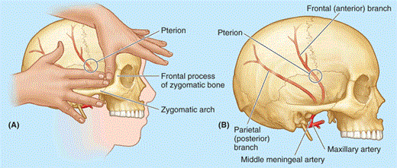
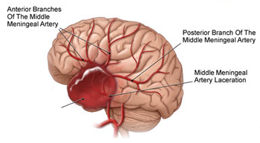
EPIDURAL HEMATOMA
Blood in between skull and dura mater
Classic: middle meningeal artery tear
Lenticular / biconvex
Lucid interval
Can be rapidly fatal
Early evacuation essential

Slide 32
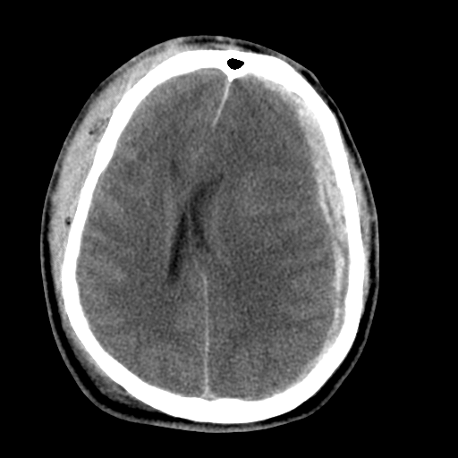
SUBDURAL HEMATOMA
Sudden acceleration-decelaration → tearing of bridging dural veins/ brain laceration
Venous origin hence collect more slowly
Susceptible for elderly/ chronic alcoholics/ children < 2years
*Rapid surgical evacuation recommended, especially if thickness >10mm or > 5 mm shift of midline
*Source: UptoDate Neurosurgery.2006;58(3Suppl): S16 on Surgicalmanagement of acute subdural hematomas
Notes:
CT scan, acute subdural hematomas are hyperdense (white), crescentshaped
lesions that cross suture lines.

Slide 33
CEREBRAL CONTUSION/ INTRACEREBRAL HEMATOMA
Most common: frontal / temporal lobes
Coup / contracoup injuries
Most conscious patients: no operation

Slide 34
SUBARACHNOID HEMORRHAGE
Disruption of parenchyma and subarachnoid vessels → blood in CSF
Headache, photophobia, meningeal signs
Traumatic SAH vs non traumatic has 3x higher mortality risk (42% vs 14%)
Notes:
Most common ct finding in moderate to severe tbi
In early injury it can be missed,usually will repeat after 6-8 hours.

Slide 35
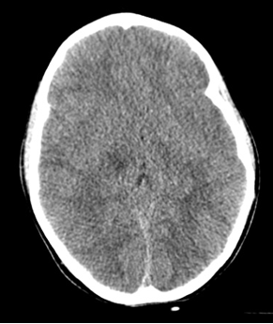
DIFFUSE AXONAL INJURY
Disruption of axonal fibers in white matter and
brainstem
Range from mild concussion to severe ischemic insult
Severe DAI, edema can develop rapidly → irreversible neurologic deficits
CT findings: Normal but classic punctuate hemorrhagic injury along grey-white junction of cerebral cortex and within deep structure of brain
Notes:
(sudden deceleration generate
shearing force on neurons)
Prevent 2nd damage by reduce cerebral edema

Slide 36
ACUTE COMPLICATIONS

Slide 37
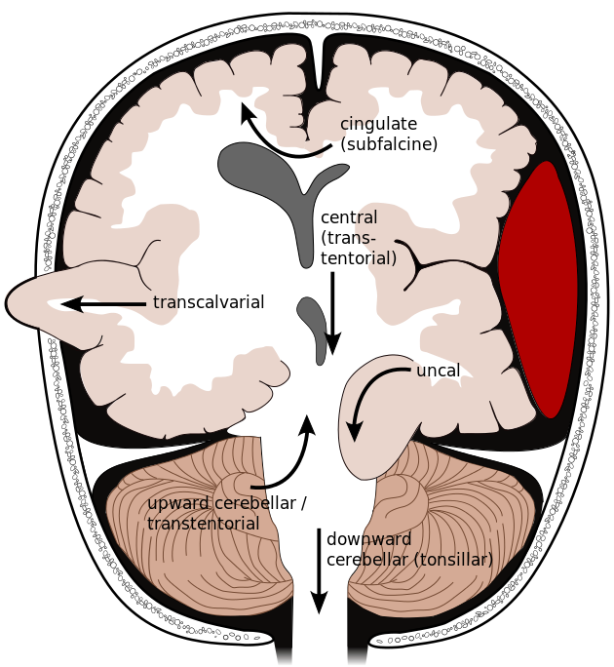
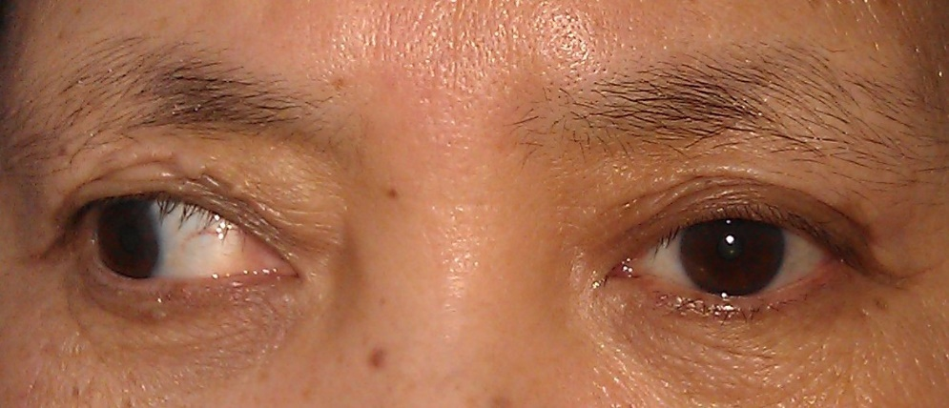
BRAIN HERNIATION
There are 5 major brain herniation syndromes:
Uncal transtentorial
Central transtentorial
Cerebellotonsillar
Upward posterior fossa
Subfalcine
Notes:
The most common is uncal herniation, which occurs when the uncus of the temporal lobe is displaced inferiorly through the medial edge of the tentorium. This is usually caused by an expanding lesion in the temporal lobe or lateral middle fossa.
Uncal transtentorial herniation leads to compression of parasympathetic fibers running with the third cranial (oculomotor) nerve, causing an ipsilateral fixed and dilated pupil due to unopposed sympathetic tone.
Further herniation compresses the pyramidal tract, which results in contralateral motor paralysis.
In some cases, the pupillary changes can be contralateral, whereas the motor changes are ipsilateral.
Central transtentorial herniation is less common and occurs with midline lesions, such as lesions of the frontal or occipital lobes, or vertex.
The most prominent symptoms are bilateral pinpoint pupils, bilateral Babinski’s signs, and increased muscle tone.
Fixed midpoint pupils follow along with prolonged hyperventilation and decorticate posturing.
Cerebellotonsillar herniation occurs when the cerebellar tonsils herniate through the foramen magnum. This may lead to pinpoint pupils, flaccid paralysis, and sudden death.
Upward transtentorial herniation results from a posterior fossa lesion and leads to a conjugate downward gaze with absence of vertical eye movements and pinpoint pupils.

Slide 38

Uncus of the temporal lobe is displaced inferiorly through the medial edge of the tentorium.
Due to an expanding lesion in the temporal lobe or lateral middle fossa.
Cx:Ipsilateral fixed & dilated pupil due to compression of parasympathetic fibers running with the 3rd cranial (oculomotor) nerve.
Compresses the pyramidal tract,results in contralateral motor paralysis.

Slide 39

Unilateral SOL pushes across the midline under the inferior “free” margin of falx,extending to contralateral side
Ipsilateral ventricle appears compressed and displaced across midline
Complications:
Obstructive hydrocephalus
Secondary ACA infarct

Slide 40


Midline lesion or diffuse swelling of cerebral hemisphere results in vertical displacement of the midbrain and diencephalon through tentorial hiatus.
Most prominent symptoms are bilateral pinpoint pupils, bilateral Babinski’s signs, and increased muscle tone.
Fixed pinpoint pupils follow along with prolonged hyperventilation and decorticate posturing.

Slide 41

Cerebellar tonsils are displaced inferiorly and become impacted into foramen magnum
pinpoint pupils, flaccid paralysis, and sudden death.

Slide 42

Caused by expanding posterior fossa mass
Cerebellum move up through the tentorial opening
Conjugate downward gaze with absence of vertical eye movements and pinpoint pupils.

Slide 43
SEVERE TRAUMATIC BRAIN INJURY

Slide 44
CEREBRAL RESUSCITATION
Principles
Physical
Physiological
Pharmacological
Surgical
Restoring cerebral blood flow and preventing secondary insult
Consult neurosurgeon early!

Slide 45
PHYSICAL
Head elevation 30°
Avoid excessive flexion of the head or pressure around the neck that may impair cerebral venous drainage
Insertion of orogastric tube (in basal skull #)
Insertion of urinary catheter (if no bladder injury)

Slide 46
PHYSIOLOGICAL
Ensure normovolemia, maintain SBP>100mgHg to ensure adequate CPP
Ensure normothermia (aim 36-37°C)
Adequate oxygenation
Ensure normocapnia, aim 35-45mmHg
Maintain glycemic control 4-8mmol/l

Slide 47
PHARMACOLOGICAL
Control epileptic activity with anti epileptic
Consider RSI with cerebroprotective advantages.
Ensure adequate sedation and analgesic

Slide 48
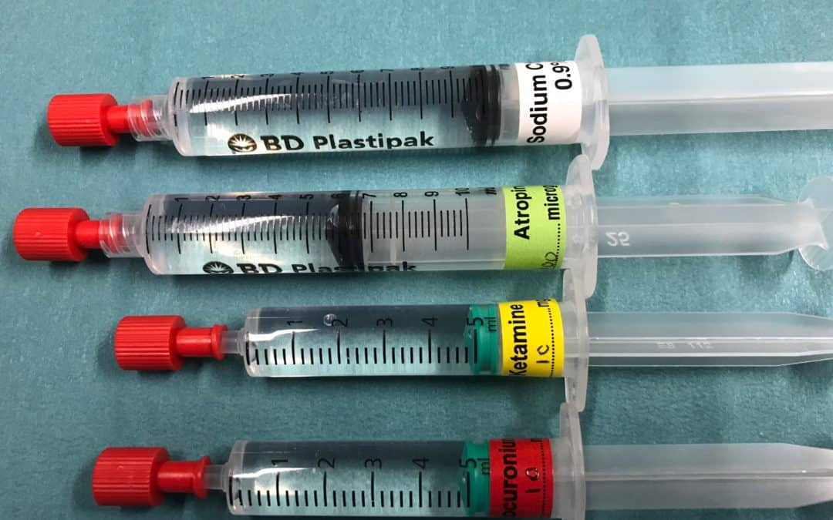
Pharmacotherapy for Drug-Assisted Intubation
Propofol is recommended for the control of ICP
Short acting IV benzodiazapines, such as midazolam, may be used for sedation and reversed with flumazenil
(ATLS 10th Edition, BrainTraumaFoundation.org 4th Edition)
Post-intubation sedation and analgesia
DRUG | DOSAGE
SEDATION
Benzodiazepine Midazolam | IV Infusion 0.05 – 0.1mg over at least 2 – 5 mins
ANALGESIA
Opiods Fentanyl Morphine | 0.5 - 2µg/kh/h continuous infusion 0.05 – 0.1mg/kg/hr continuous infusion
(CPG Early Mangement of Head Injury in Adults 3rd Edition 2015)
Notes:
Anesthetics, sedation, and analgesic agents should
be used cautiously in patients who have suspected
or confirmed brain injury. Overuse of these agents
can cause a delay in recognizing the progression of a
serious brain injury, impair respiration, or result in
unnecessary treatment (e.g., endotracheal intubatio

Slide 49
DRUGS | ADVANTAGES | DISADVANTAGES
FENTANYL | Attenuate rises in BP & HR Neuroprotective in patient with raised ICP.
LIDOCAINE | Bronchodilator effect | Caused hypotensive
ETOMIDATE | Reduced ICP Rarely reduced BP | No analgesic property Can decreased seizure threshold,myoclonic jerks
KETAMINE | Increased BP-Neuroprotective (suited in TBI with normal/reduced BP) Bronchodilator Dissociative amnesia | Increased ICP Increased secretions
PROPOFOL | Stop seizure Bronchodilation | No analgesic Cause hypotensive reduced CBF
MIDAZOLAM | Anticonvulsant Reversible | Lack of analgesic Apnea
SUCCINYLCHOLINE | Short acting
ROCURONIUM | Ideal in patient status epilepticus (due to long action of paralysis)

Slide 50
SURGICAL
Decompression craniectomy
Surgical drainage of hematoma

Slide 51
Other clinical parameters
PARAMETERS | RANGE | PARAMETERS | RANGE
Temperature | 36–38°C | PaO2 | ≥ 100 mm Hg
Glucose | 80–180 mg/dL | PaCO2 | 35–45 mm Hg
Hemoglobin | ≥ 7 g/dl | pH | 7.35–7.45
Platelets | ≥ 75 X 103/mm3 | CPP | ≥ 60 mm Hg*
INR | ≤ 1.4 | Intracranial pressure | 5–15 mm Hg*
Na | 135–145 meq/dL | PbtO2 | ≥ 15 mm Hg*
Pulse oximetry | ≥ 95%
Data from ACS TQIP Best Practices in the Management of Traumatic Brain Injury. ACS Committee on Trauma, January 2015.

Slide 52
MILD TRAUMATIC BRAIN INJURY
Post resuscitation GCS 13 – 15
Often sustained a concussion; transient loss of neurologic function following a head injury
Can be confounded by alcohol or other intoxicants
Physical findings in isolated mild TBI are often normal
Indications for CT Brain are based on Canadian CT Head Rules/ New Orleans

Slide 53
Mild TBI
TRANSFER / ADMIT
CT scan is indicated if criteria of high or moderate risk of neurosurgical intervention are present
DISCHARGE
Abnormal CT scan
All penetrating head injuries
Prolonged loss of consciousness
Deteriorating level of consciousness
Moderate to severe headache
Significant alcohol/ drug intoxication
Skull fracture
CSF leak
Significant associated injuries
No reliable companion at home
Abnormal GCS score after 2 hours
Persistent focal neurological deficits
Patient does not meet criteria for admission
Observe in ED at least 6 hours
Discuss need to return if any problems develop and issue a “warning sheet”

Slide 54
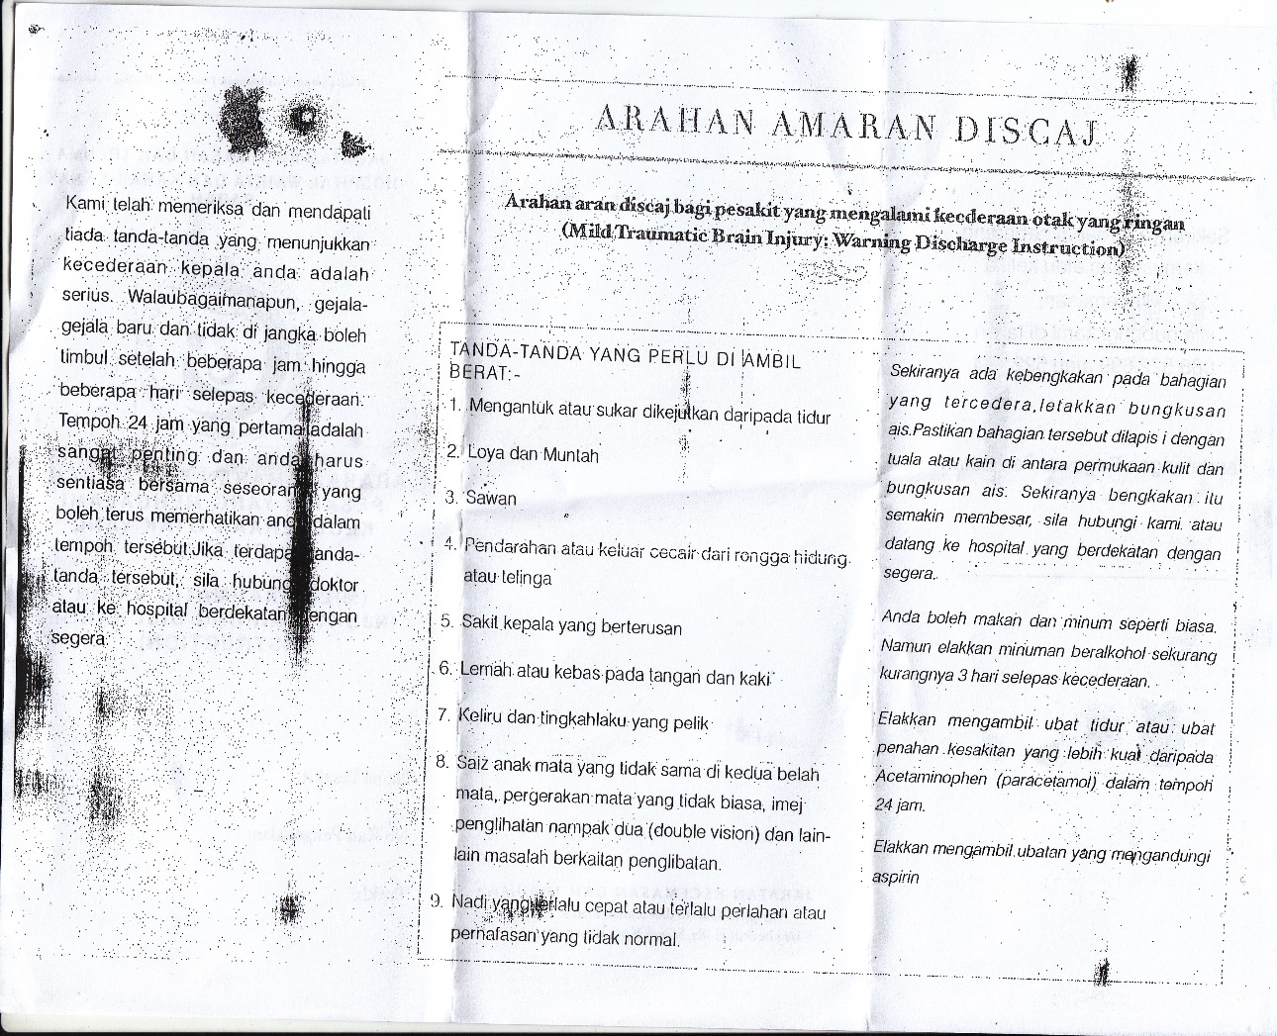
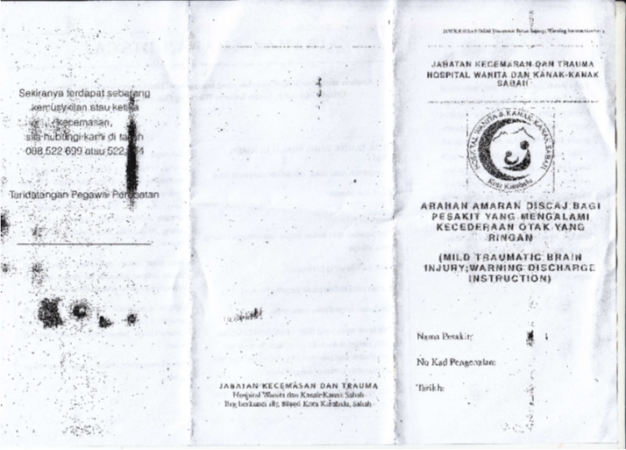

Slide 55
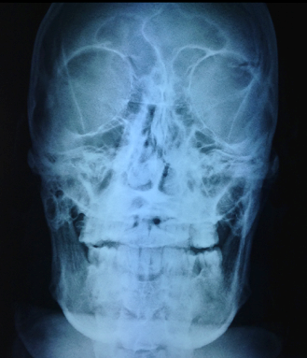
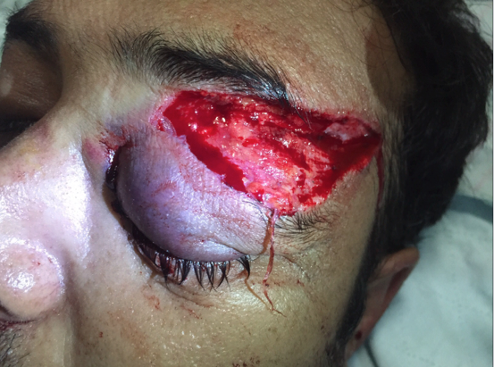
CASE STUDY
Notes:
Skull fractures are detected on plain radiographs in 5% of patients with mild head injuries, but the detection of a skull fracture on a radiograph is regarded as an indication for CT evaluation. Therefore, obtaining a radiograph can only delay the diagnosis of an associated intracranial injury

Slide 56
DOES SKULL XRAY HAS ROLE IN SUSPECTED TBI?
NICE Guidance - Head injury: assessment and early management (last updated on 2017)
Do not use plain X-rays of the skull to diagnose significant brain injury without prior discussion with a neuroscience unit. However, they are useful as part of the skeletal survey in children presenting with suspected non-accidental injury. [2007]
When compared with autopsy, X-ray missed 19.1% of fractures while 11.9% fractures missed in CT scan. The limited sensitivity of X-ray in detection of skull fracture makes it unreliable. Skull radiograph is of little benefit when a CT scan is obtained. It has no added advantage over CT scan. Whenever there is facility of CT scan is available, the patient of head injury should not undergo skull radiograph
*J Clin Diagn Res. 2015 Jun; 9(6): TC13–TC15 on Diagnostic Utility of Conventional Radiography in Head Injury
Head CT is the investigation of choice to identify ICH following head injury. The plain skull Xray is ineffective screening tool in predicting ICH in MHI with a mean sensitivity of 50.0% and a mean specificity of 97%. It is confirmed that skull radiography is of little value in the clinical assessment of mild TBI
* CPG Early Management of Head Injury in Adults 2015
*http://jnnp.bmj.com/content/68/4/416: Value of radiological diagnosis of skull fracture in the management of mild head injury: meta-analysis

Slide 57
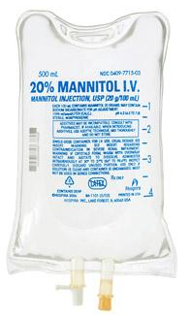
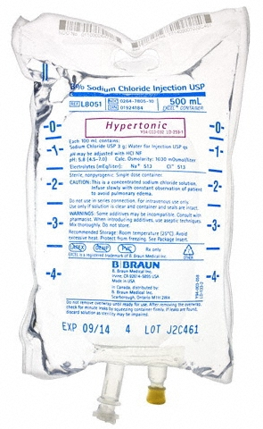
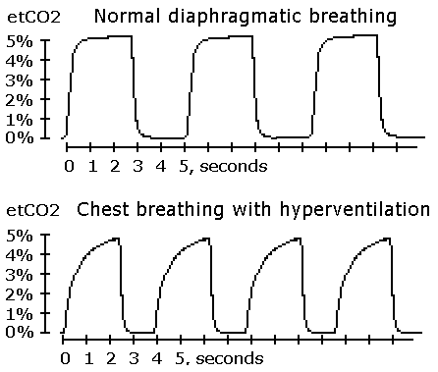
HYPERVENTILATION
Hyperventilation acts by↓ PaCO2 and causing cerebral vasoconstriction.
This risk is particularly high if the PaCO2 is allowed <30 mm Hg
Hypercarbia (PCO2 > 45 mm Hg) will promote vasodilation and increase intracranial pressure
MANNITOL
For elevated ICP
Do not give mannitol to patients with hypotension (<90mmHg)
Recommended Dose : 0.25–1 g/kg to control elevated ICP
In acute neurological deterioration, give bolus of mannitol (1 g/kg) rapidly (over 5 minutes)
HYPERVENTILATION
HYPERTONIC SALINE
Hypertonic saline is also used to reduce elevated ICP
Preferable agent in hypotensive patients, as it does not cause diuresis
Study has shown, between mannitol and hypertonic saline in hypovolemic patients, neither adequately lowers ICP
CONTROVERSIAL ISSUES
HYPERTONIC SALINE
MANNITOL

Slide 58
VERDICT
Brief periods of hyperventilation
PaCO2 of 25 to 30 mm Hg may be necessary to manage acute neurological deterioration while other treatments are initiated (craniotomy)
Mannitol can be used in increased ICP, provided no hypotension
Hypertonic saline is preferred in hypotensive patient

Slide 59


NEWBORNS | Delivery head injury Cephalohematoma Subgaleal hematoma Intracranial hemorrhage | Caused by head compression and traction through the birth canal (vagina delivery) with obstetric instruments Premature baby are risk factor for intracranial haemorrhage.
INFANTS | Accidental head injury Abusive head trauma | Caused by inappropriate childcare practise If mechanism of injury is not clear,consider for child abuse. AHT is the most common cause of TBI related hospitalisation and death
TODDLERS & SCHOOL CHILDREN | Accidental head injury | Caused by accidents increase as child develop motor ability Pedestrian injury also increases In this age group.
ADOLESCENTS | Bicycle and motorcycle related accidents Sports related head injuries | Trainers and players those involved in contact sports will require education about concussion.
Paediatric Traumatic Brain Injury.Neuro MED Chir (Tokyo) 2017 Feb;57(2);82-93

Slide 60
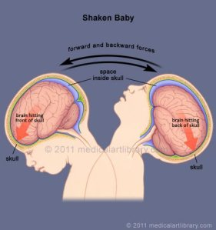
SHAKEN BABY SYNDROME
Most common cause of NAI/abuse
Large heavy head
Weak neck muscle
Fragile central nervous system
Notes:
A baby’s head and neck are susceptible to head trauma because his head bigger in proportion to the rest of body and muscles are not fully developed and the brain tissue is very fragile.Any violent shakes will cause head to fling out of control
When shaking oocur,brain bounces front and back within skull (coup and countercoup) will cause
-blood vessel:shearing of bridging vein,sdh-increase pressure,brain swollen-nerve injured,brain damage
-retinal haemorrhage
-brain stem: respi problems

Slide 61
COMMON PRESENTATION
Lethargy/poor muscle tone
Decreased appetite,poor feeding/sucking,vomiting
Extreme irritability
Grab type bruises on arm or chest
Seizures
Difficulty breathing
Broken bones
Mental retardation

Slide 62
SUMMARY
Primary goal of treatment is to prevent secondary brain injury
Ensure adequate oxygenation and prevent hypotension
Know the indications for CT brain imaging
Skull X-ray has no role as diagnostic imaging

Slide 63
REFERENCES
Advance Trauma Life Support 10th Edition: Chapter 6 Head Trauma page 104 – 125
Textbook of Tintinalli Emergency Medicine 8th Edition: Chapter 257 Head Trauma page 1695 - 1707
CPG Early Management of Head Injury in Adults (2015)
Guidelines for the Management of Severe Traumatic Brain Injury 4th Edition
www.braintraumafoundation.org
National Institute for Health and Care Execellent Guidance: Head injury –Assessment and early management
https://www.nice.org.uk/guidance/cg176
Gelb, Adrian W.White, Hayden MD, Venkatesh, Bala MD et al. Cerebral Perfusion Pressure in Neurotrauma: A Review. Anesthesia & Analgesia: September 2008 - Volume 107 (3):979-988
Takashi araki, Hiroyuki yokota,Akio Morita.Paediatric Traumatic Brain Injury.Neuro MED Chir (Tokyo).2017 Feb;57(2);82-93
Hofman PA, Nelemans P, Kemerink GJ, et al. Value of radiological diagnosis of skull fracture in the management of mild head injury: meta-analysis. J Neurol Neurosurg Psychiatry. 200068(4):416-422.
https://journals.lww.com/anesthesia-analgesia/Fulltext/2008/09000/Cerebral_Perfusion_Pressure_in_Neurotrauma_A.45.aspx

